Slide 1
Test Driven Development
Notes:
.

Slide 2
Test Driven Development (introduction)
Objectives
Explain the motivation, process and core techniques of TDD
Contents
Traditional (Test Last) Development
Test First Development
TDD Process: Worked Example
TDD Strategies
Code Smells
Common Refactorings
Exercise
Notes:
.

Slide 3
Traditional development
Code – Test – Refactor
Tests as an afterthought
“If there’s time”/leave to testers
Problem: high level of defects
Lengthy testing phase after a release is frozen
Cost of fixing bug discovered then far higher than if bug caught when introduced into code
Problem: poor maintainability
Legacy spaghetti code that ‘works’
Can't be touched – fearing of breaking

Slide 4
Test driven development
Core practice of XP
Can be adopted within other methodologies
"Test-first programming is the least controversial and most widely adopted part of Extreme Programming (XP). By now the majority of professional Java™ programmers have probably caught the testing bug" – Elliotte Rusty Harold
Test written before implementation
Tools and techniques make TDD very rigorous process
aka Test Driven Design
Tests drive design of API
Developers become "Test infected" (Eric Gamma)
Cannot program without test first
Notes:
For me, it is inconceivable that in today’s world any serious developer would develop an application without using a modern IDE with powerful refactoring capabilities, and develop their code in a largely test-driven manner. The risks of not driving development through tests are too great.
When you’ve done TDD, you will be familiar with this experience: “I’ll just make this little change, I know it’s not going to have any consequences”… and then you re-run the tests, only to find that some tests are now red. “Oh yes, of course… that change led to this consequence, which led to that now being wrong.”
If you hadn’t got the suite of tests covering your code base, that little bug would have insinuated itself into your application, only to come to light some months later, requiring someone to spend a lot of time tracking it down, with who knows how many other repercussions for other bits of the code.
So, when you become ‘test infected’, when you have some new bit of functionality to implement, you don’t just dive in and start coding away. You sit back and ask yourself: “So, how am I going to specify my next step in a test?” And sometimes you may find yourself not being ‘productive’ in a conventional sense, thinking about your tests, discussing them with your colleagues, reorganising your tests, breaking large test classes up, extracting common setup to superclasses etc. And then suddenly you may be able to write a whole bunch of new tests, and then surprisingly quickly implement the code which they specify.

Slide 5
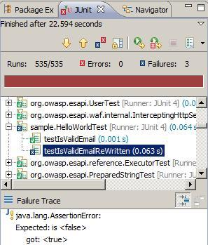
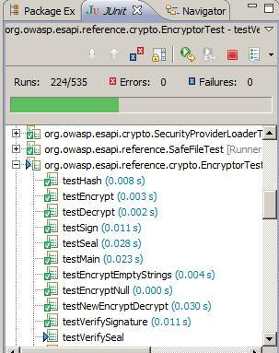
Test driven development
Test – Code – Refactor
Kent Beck's summary of TDD:
1. Write new code only if you first have a
failing automated test
2. Eliminate duplication
Red – Green – Refactor
Notes:
The graphic on the left illustrates that the famous green bar is indeed a progress bar. The image on the right shows the final outcome of running this series of tests: there are 3 failures.

Slide 6
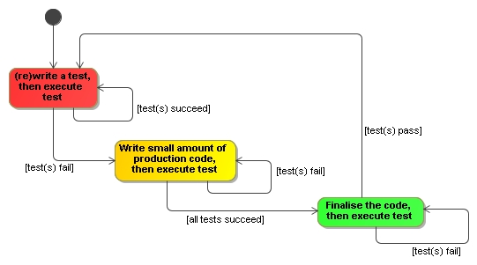
Red-green-refactor workflow
Failure expected on first run
Refactor code to bring it to production quality
Incrementally develop the system, using tests to guide the required features

Slide 7
TDD process
First write the test
Designing the API for the code to be implemented
Using an API (in tests) is best way to evaluate its design
Write just enough code for test to pass
Minimises code bloat
Keeps developer focussed on satisfying the requirement embodied in the test
Refactor: change some code w/o changing functionality
“A disciplined technique for restructuring an existing body of code, altering its internal structure without changing its external behaviour" – Fowler
Develop in small iterations: “test a little – code a little”

Slide 8
TDD worked example
Task: find the highest number in an array of ints
1. Start by writing test (e.g. ArrayUtilsTest class)
What’s a good simple starting case?
Find the highest in an array with one number
What should we call the test method?
e.g. findHighestInArrayOfOne()
How do we express this test – what are we asserting?
assertThat(ArrayUtils.findHighest(array), is(10));
Arrange any fixtures
int[] array = {10};

Slide 9
TDD worked example
2. Make it compile (do just enough)
public static int findHighest(int[] numbers) {
Generally, return 0 or null, etc.
3. Make it fail (run test and verify red)
Using matchers: Expected: is <10> got: <0>
4. Make it pass (do minimum to go green)
return 10;
5. Make it right (remove duplication)
Remove dependency of code on test
Duplication test data in solution code
return numbers[0];
Notes:
At step 3 we run the test and get JUnit's Red bar. In TDD, this constitutes success: we have completed the first essential step, writing a failing test.
At step 4 we do the least to get the test to pass – run the test again: Green bar.
Kent Beck writes, "Steve Freeman pointed out that the problem with the test and code as it sits is not duplication ... The problem is the dependency between the code and the test—you can’t change one without changing the other. Our goal is to be able to write another test that “makes sense” to us, without having to change the code, something that is not possible with the current implementation.
... If dependency is the problem, duplication is the symptom."
-from Test-Driven Development By Example
At step 5 ask yourself:
- have we specified some functionality in the form of a test?
- have we satisfied what the test requires?

Slide 10
TDD worked example
6. Devise next test: what’s next bit of functionality?
findHighestInArrayOfTwo()
Make it fail (i.e. don’t make array {20, 10} )
7. Solution: need to handle variable length array
int highestSoFar = Integer.MIN_VALUE;
for (int i = 0; i < numbers.length; i++) {
if (numbers[i] > highestSoFar)
highestSoFar = numbers[i];
8. ‘Triangulate’ – add further tests
E.g. findHighestInArbitraryArray()
9. Ensure corner cases are covered. What about { } ?
Notes:
What should we do about the empty array?
Return an int? Any value we could provide, e.g. 0, or Integer.MIN_VALUE, would be incorrect
Throw a checked exception? It seems a bit extreme to make ordinary clients handle this exception if this is a rare and unusual case
Throw a runtime exception. Start by specifying with the annotations syntax:
@Test(expected=RuntimeException.class)
public void findHighestInEmptyArrayThrows() {
int [] array = {};
ArrayUtils.findHighest(array);
}
Then if appropriate, refine to the more explicit format:
@Test public void findHighestInEmptyArrayThrowsWithMsg() {
int [] array = {};
try {
ArrayUtils.findHighest(array);
fail("An exception should have been thrown");
} catch (RuntimeException e) {
assertThat(e.getMessage(), is("Empty array"));
}

Slide 11
TDD – benefits
Build up library of small tests that protect against regression bugs
Extensive code coverage
No code without a test
No code that is not required
Almost completely eliminates debugging
More than offsets time spent developing tests
Tests as developer documentation
Confidence not fear
Confidence in quality of the code; confidence to refactor
Notes:
A regression bug is a defect which stops some bit of functionality working, after an event such as a code release, or refactoring.

Slide 12
Code smell
Code smell: symptom of something wrong with code
Not necessarily a problem, but needs consideration
Typically an anti-pattern for a refactoring
Large class
Class that has too much in it; aka God-like object
Feature envy
A class that uses the methods of another class excessively
Inappropriate intimacy
Class has dependencies on implementation details in another
Switch statement
May point to better design using polymorphism
Notes:
"Code smell" has become a common phrase in the XP/TDD community, promoted in Martin Fowler's Refactoring: Improving the Design of Existing Code. Here are just four representative examples. Switch statement illustrates that these are only indicative; a particular use of a switch statement may be a perfectly appropriate flow control construct.

Slide 13
Benefits of refactoring
Makes code easier to understand
Improves code maintainability
Increases quality and robustness
Makes code more reusable
Typically to make code conform to design pattern
Many now automated through Eclipse, etc.
Refactoring ≠ Rewriting
Notes:
Koskela: "Do. Not. Skip. Refactoring
… The single biggest problem I've witnessed after watching dozens of teams take their first steps in test-driven development is insufficient refactoring." (Test Driven, p. 106)
Martin Fowler's site refactoring.com is a useful resource. See e.g. the catalogue of refactorings at:
http://www.refactoring.com/catalog/index.html
Another on-line catalogue of refactorings is available at:
http://industriallogic.com/xp/refactoring

Slide 14
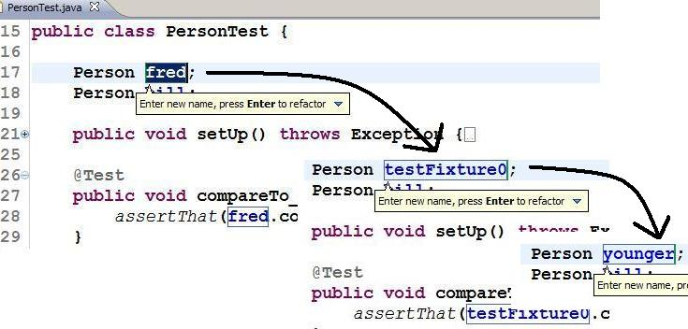
Common refactorings
Refactor Rename. Eclipse: <ALT> <SHIFT> R
Keep doing until you are satisfied you have an identifier that best reflects what the item represents
Notes:
At all times think how you can make your code maximally self-documenting. Aim to replace unclear and ambiguous identifiers with clear and informative ones. For a variable, choose a name which reflects what it represents in the problem domain, not its implementation (e.g. in the enhanced for loop, nextClient rather than nextElement). Only choose one-letter identifiers for variables such as array indexes.
Refactor-rename is much smarter than a manual edit of the file
Rename a variable: renames all occurrences
Rename a class: renames the compilation unit too (the .java file), and all known references to the class
Rename a method: renames all known calls to that method
Rename a package: renames all the package declarations within

Slide 15
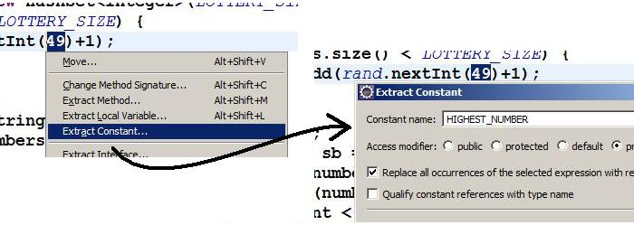
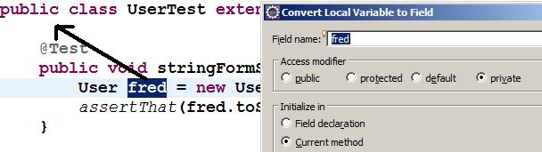
Common refactorings
Extract Constant – aka “No Magic Numbers”
Highlight literal (e.g. int or String), then <ALT> <SHIFT> T
Convert Local Variable to Field
Notes:
You should avoid hard-coding literal values, like ‘49’, into your code. The essential issue is to do with the comprehensibility of the code: someone coming along to maintain it will be scratching their head wondering what this number represents. There is also likely to be the issue of maintainability in the sense that quite likely this value will occur more than once, and maybe it will need to be revised.
In Eclipse, highlight the number, then <CTRL> <SHIFT> T, the general context menu for refactoring. Select Extract Constant, choose a meaningful name: the constant will be declared as a class field, and the literal occurrence you selected will be replaced. NB if there are further occurrences of the value within the class, you need to search for them manually and replace them.
For Convert Variable to Field, you highlight a variable local to a method so that you can pull it to class field level. This could be part of a “remove duplication” refactoring – certainly in the case of a unit test fixture, as illustrated. There are a couple of decisions to be addressed. Since the variable is now a class-level field, what class accessibility should it have? The options are: i) field declaration – i.e. the whole line is in effect pulled out of the method; ii) in the current method – i.e. the declaration User fred; is pulled up to the class level and the initialisation remains where it is; iii) in the class constructors – i.e. as ii), but the initialisation statement will be moved to all and any constructors. None of these is quite right for a Test class, so best is to accept ii then manually move it to setUp().

Slide 16
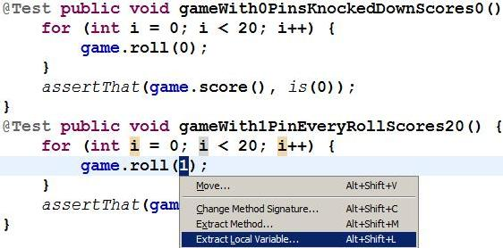
Remove duplication
DRY: Don’t Repeat Yourself!
E.g. 2 blocks of code which are almost identical
Extract value(s) where they differ to variable(s)
Will become input parameter(s) to single common method
Place declaration of local variable int pins = 1 outside loop
Apply Extract Method refactoring to for loop
Notes:
This example (a variant of the one in Bob Martin’s Bowling Game Kata), the test methods would end up looking like, e.g.
@Test public void gameWith0PinsKnockedDownScores0() {
roll20(0);
assertThat(game.score(), is(0));
}
with the commonality between the two blocks of code captured in the method:
private void roll20(int pins) {
for (int i = 0; i < 20; i++) {
game.roll(pins);
}
}
You don't need to be an adherent of TDD or XP to recognise the importance of Remove Duplication. Duplication of logic or responsibility is anathema to good code, because of the risks it introduces for maintenance: the risk of making a change in one place but not another.

Slide 17
Summary
TDD: big change to developers' mindset and practices
Test – Code – Refactor
Write a test: specify the next bit of logic you are about to write
Make it fail: verify that the test specifies something that has not yet been implemented
Make it pass: do just enough
Make it right: refactor
Develop in small increments
Follow unit testing best practices
Make tests clear, maintainable, fine-grained, independent
Ensure good coverage of negative (abnormal flow, errors) as well as positive (normal flow)

Slide 18
Test Driven Development Lifecycle

Slide 19
Contents
Red – Green – Refactor
Acceptance criteria and testing
Writing acceptance criteria
Acceptance criteria and TDD
Zero Quality Control
Focused Testing

Slide 20
Red-green-refactor workflow
Failure expected on first run
Refactor code to bring it to production quality
Incrementally develop the system, using tests to guide the required features

Slide 21
Acceptance Criteria or Testing
An acceptance criteria is NOT acceptance test
An acceptance criteria
Is a set of conditions provided by the customer
Can be expressed as
Given <some precondition>
When <actor performs some action>
Then <some observable result>
Acceptance tests = acceptance criteria + scenarios with instance values (data)
Agile should NOT be an excuse for NOT doing Business analysis or system designs
Notes:
We still need to ask, “Are we building the right product?” and “Are we building the product right?”

Slide 22
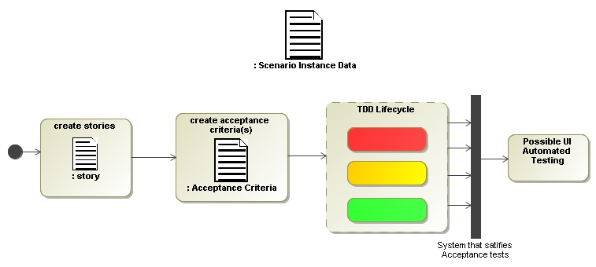
Acceptance TDD
generates
feeds into
Notes:
This is great because it will lead us to a place where we can specify the criteria for completion and way of offering feedback in situations where tests fail. It’s also a collaboration tool and offers real data to measure progress.

Slide 23
When is DONE done?
Mike Cohn’s groups testing as follows
GUI
Tests
Small in number, using tools such as: Selenium, Sahi, Watir, Abbot and Frankenstein
Acceptance
Tests
At least one per story, using tools such as: FIT, FitNesse, Rspec an JBhave
Unit
Tests
At least one per class or module, using tools such as: Nunit, Junit, TestNG
When every story has at least one acceptance test
When a story passes its acceptance test

Slide 24
JUnit
OVERVIEW
Notes:
Manual testing – this is you using your code and seeing if it is working
Can become a tedious process if you are using a self built interface
The point of it is when you are developing a program you want to be able to build a test for this piece of functionality to prove that it works.
In development when we change one thing we can break things elsewhere in the system
Fail fast – as soon as something you have immediate feedback that something has failed
Tests have quite a few different aspects
Improve the quality of code by finding defects / bugs
Building confidence in the program – prove that your product works – the client will want to see that the system with a fully fledged test suite that covers 80% of your code – 80% of the code is touched by tests
How we accomplish this is really simple, its an external library that gives us some nice output.

Slide 25
JUnit with Maven (part 1)
Open Eclipse
File > New > Other
Expand “Maven” folder
Select “Maven project”
Specify where you want your project saved and Next
Select archetype I’d say go for the “maven-archetype-quickstart”
Group Id is conventionally “com.qa.quickstart” or something similar
Specify Group Id/Artifact Id
New project will be created and added to the project explorer on the left side menu

Slide 26
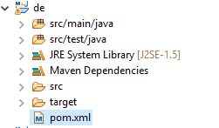
JUNIT WITH MAVEN (PART 2)
Depending on the naming of artifactId you used, the root project will be called something different than “De”

Slide 27
JUnit with Maven (part 3)
Open “pom.xml”
By default it will open up in the “Overview” view, you want to change it to the “pom.xml” view, you can do it at the bottom of eclipse window
Next you will see inside the pom file that there will be the ArtifactId, GroupId and the rest of the things, what we’re interested is the dependencies part of the pom file
You can should see that there are two pairs of tags that are used to add dependencies, one is the parent tag called “dependencies” which is basically a collection of dependencies for the project. Inside of the “dependencies” we have the child tags that are used for a single dependency we want to add so if we wanted to have multiple dependencies we would have more than one pair of “dependency” tags. We see that there is already added a dependency for Junit, which act’s as a good example on how it should be done.

Slide 28
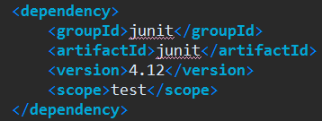
JUNIT WITH MAVEN (PART 4)
This is the dependency and version number that is required for JUnit.

Slide 29
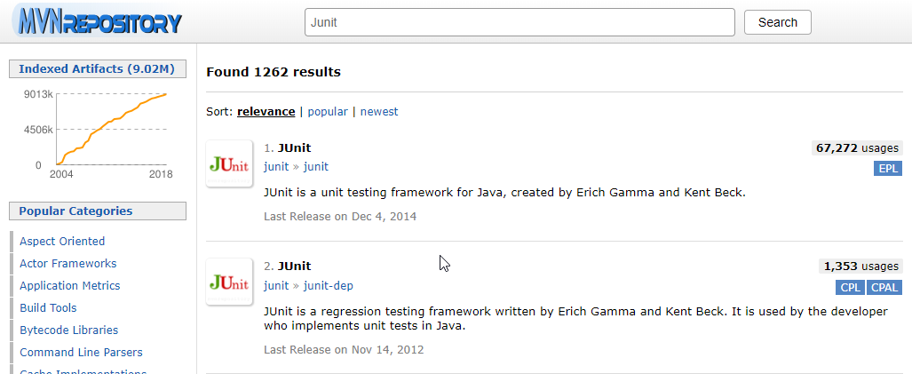
JUNIT WITH MAVEN (PART 5)
We can get most of the dependencies from https://mvnrepository.com/ if we were to search for Junit using the search bar at the top of the page, you would see the results for what libraries were found, we want the JUnit one which is the first result

Slide 30
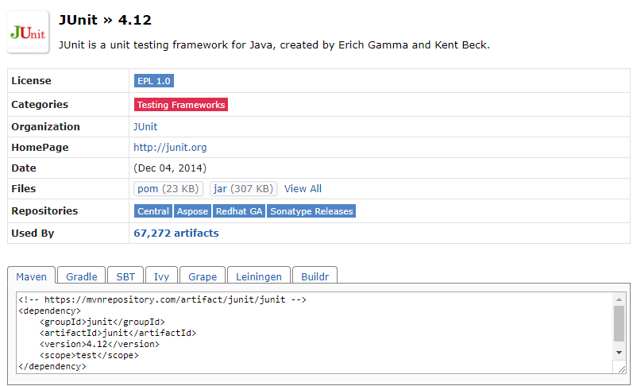
JUNIT WITH MAVEN (PART 6)
Next we select the version that we want to use…

Slide 31
JUnit with Maven (Part 7)
At the bottom you should see the Maven tab selected and a dependency inside of it
We would copy this dependency and add it to inside the “dependencies” tags and then it would become a dependency for our project
You can similarly find all sorts of dependencies you might need using this method, for example Selenium or Apache POI.

Slide 32
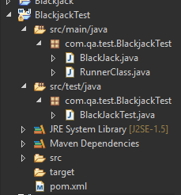
SETTING UP JUNIT
Next thing that we need to do is to create a new Junit test – similar to how you have been creating Java classes within Eclipse.
Conventionally this is done in the src/test/java folder.
To do this, Right-click the folder > new > Class, and then specify the name for the class.

Slide 33
SETTING UP JUNIT (CONT.)
This code on the left is similar to what Eclipse will auto-generate for you.
Import static org.junit.Assert.* allows us to use all the methods (e.g. AssertEquals) from the Junit.Assert Library. The import org.junit.Test allows us to use the @Test annotation
Here we are creating a test for the BlackJack Exercise you completed earlier, the first test, BlackJackTest, is set to fail by default.
package Test;
import static org.junit.Assert.*;
import org.junit.Test;
public class BlackJackTest {
@Test
public void test() {
fail("Not yet implemented");
}
}

Slide 34
SETTING UP JUNIT (CONT.)
Now we can populate our test with ‘assert’ statements.
These statements checks an expected value against the actual returned value of a method that we call.
@Test
public void test() {
BlackJack blackjack = new BlackJack();
assertEquals(10, blackjack.play(10, 22));
assertEquals(9, blackjack.play(22, 9));
assertEquals(0, blackjack.play(22, 22));
assertEquals(10, blackjack.play(10, 7));
assertEquals(19, blackjack.play(1, 19));
}

Slide 35
SETTING UP JUNIT (CONT.)
@Test
public void test() {
BlackJack blackjack = new BlackJack();
assertEquals(10, blackjack.play(10, 22));
assertEquals(9, blackjack.play(22, 9));
assertEquals(0, blackjack.play(22, 22));
assertEquals(10, blackjack.play(10, 7));
assertEquals(19, blackjack.play(1, 19));
}
System.out.println(blackjack.play(10, 22));
System.out.println(blackjack.play(22, 9));
System.out.println(blackjack.play(22, 22));
System.out.println(blackjack.play(10, 7));
System.out.println(blackjack.play(1, 19));

Slide 36
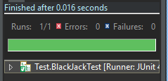
SETTING UP JUNIT (CONT.)
The previous slide showed how we may have ‘tested’ our code in that past, by visually checking the output of the methods versus what we expect it to be.
In Eclipse we run our tests the same way as we run our code.
With Junit, when the tests have been run we get a green bar to tell us that the tests have passed.
Visually this is easier to comprehend and also helps keep our code tidy.

Slide 37
JUnit – Annotations
@BeforeClass – Executes before any of the tests
@AfterClass – Executes after all of the tests.
@Before – Executes before a test
@After – Executes after a test
@Test – Signifies that the method is a test
@Ignore – Signifies to ignore the test.
@Runwith – Signifies Junit to use that class instead of the default Runner class
@Parameters – Signifies the parameter dataset to use for the test(s)
@Category – Used to add meta data for a test
@IncludeCategory – Used to include tests with specific metadata
@ExcludeCategory – Used to exclude tests with specific metadata
Notes:
Might not have seen these before possible @Override
Before a method or a variable
@BeforeClass
- symblifys when the test should be run
They are not run from the Main method
Tests are effectively a standalone file that is run separately
First 6 are quite important
Lot of control of our test suite when it does what
You may be preparing your scenario
Or resetting your data – cleaning out your data

Slide 38
@Test
Signifies the method is a test to be run.
A timeout can be added, forcing it to fail if it doesn’t finish in a certain period.
Expected Exceptions can be added, allowing the test to pass if an exception is thrown.
// fail
@Test
public void test1() {
fail("Fail");
}
// fail
@Test(timeout = 1000)
public void test2() {
try {
Thread.sleep(2000);
} catch (InterruptedException e) {
e.printStackTrace();
}
}
// pass
@Test(expected = ArithmeticException.class)
public void test3() {
throw new ArithmeticException();
}

Slide 39
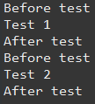
Order of Execution
@Before
public void method2() {
System.out.println("Before test");
}
@Test
public void method3() {
System.out.println("Test 1");
}
@Test
public void method4() {
System.out.println("Test 2");
}
@After
public void method6() {
System.out.println("After test");
}
@Before – Executes before a test
@After – Executes after a test
We use @Before to set up each test that we are running, as this is executed before every test, if every test requires the same setup this can minimise the amount of code we write.
We use @After to ‘tear down’ the environment in which our test is being run. Effectively we can use this to create a ‘clean slate’ for the rest of our tests.
Notes:
The ordering does not matter
This is the output
Explain the output

Slide 40
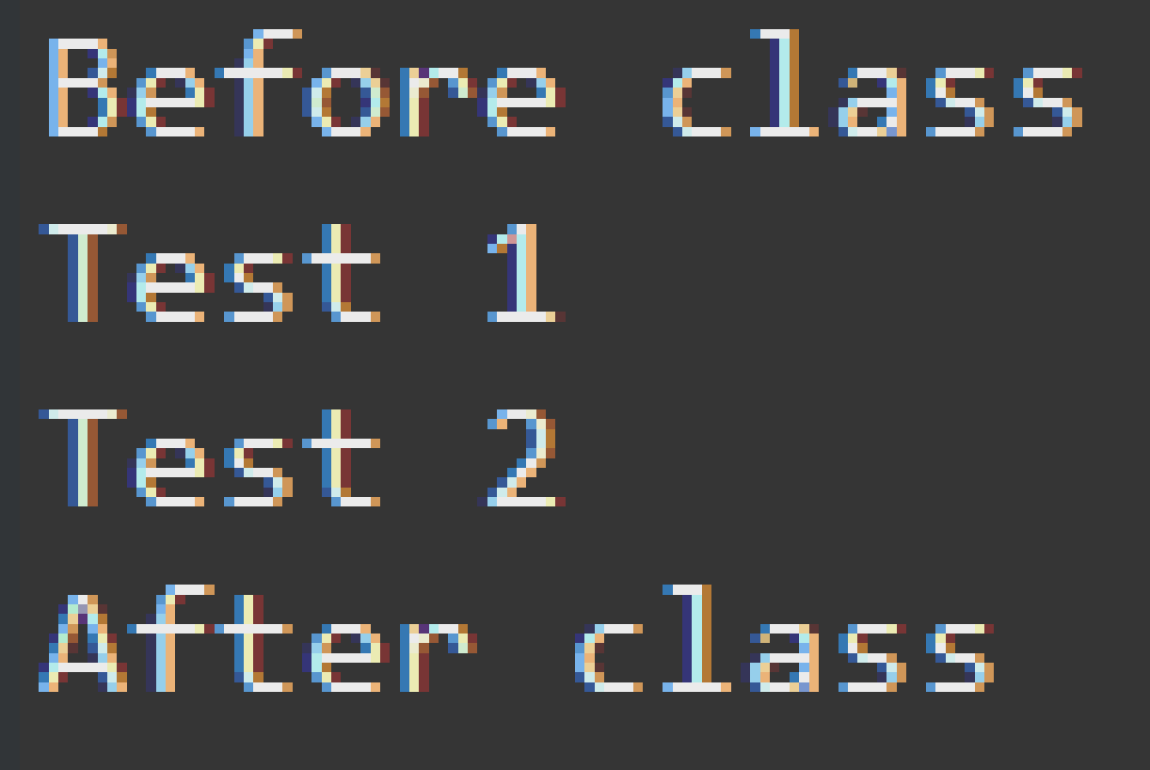
Order of Execution
@BeforeClass
public static void method1() {
System.out.println("Before class");
}
@Test
public void method3() {
System.out.println("Test 1");
}
@Test
public void method4() {
System.out.println("Test 2");
}
@AfterClass
public static void method7() {
System.out.println("After class");
}
@BeforeClass – Executes before any of the tests
@AfterClass – Executes after all of the tests.
Typically we use @BeforeClass to set up our testing environments in some way. For example when using Selenium we could set up our driver here.
@AfterClass is used to close down any streams that we may have created during the execution of our tests.
Notes:
The ordering does not matter
This is the output
Explain the output

Slide 41
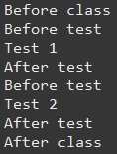
ORDER OF EXECUTION
@BeforeClass
public static void method1() {
System.out.println("Before class");
}
@Before
public void method2() {
System.out.println("Before test");
}
@Test
public void method3() {
System.out.println("Test 1");
}
@Test
public void method4() {
System.out.println("Test 2");
}
@After
public void method6() {
System.out.println("After test");
}
@AfterClass
public static void method7() {
System.out.println("After class");
}

Slide 42

Order of Execution
@Before
public void method2() {
System.out.println("Before test");
}
@Test
@Ignore
public void method3() {
System.out.println("Test 1");
}
@Test
public void method4() {
System.out.println("Test 2");
}
@After
public void method6() {
System.out.println("After test");
}
@Ignore can be used to ‘skip’ a test.
If you don’t want a particular test to be ran every time then by putting @Ignore will cause the implementation to be ignored.
Notes:
The ordering does not matter
This is the output
Explain the output

Slide 43
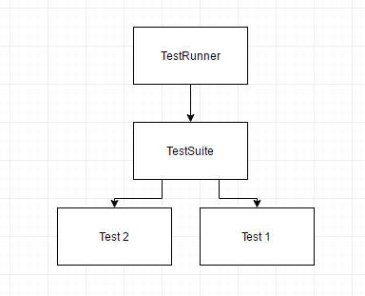
TEST SUITES
Comprised of three parts:
Test Suite class
Test Runner class
Test classes
Test runner classes runs the tests references from the test suite.
Test suite class references the test classes.
Test classes contain the tests to be run.

Slide 44
JUnit Test Methods
assertTrue(“Boolean was False”, Boolean)
assertFalse(“Boolean was True”, Boolean)
assertEquals(“Actual was not Expected”, Expected, Actual)
assertEquals(“Actual was not expected within the Tolerance”, Expected, Actual, Tolerance)
fail(“Method Failed the Test”)
assertNull(“The object is not Null”, Object)
assertNotNull(“The object is Null”, Object)
assertSame(“The objects are not the same”, Expected, Actual)
assertNotSame(“The objects not the same”, Expected, Actual)
Notes:
http://junit.sourceforge.net/javadoc/org/junit/Assert.html
Special functions for Junit
We pass it a message that it will output if the , and we give it a Boolean
assertEquals is used a lot – we are checking if the thing that is given back is the expected result
Theoretically you could use this for everything
No one expects you to use all of them
But there are 200 that exists

Slide 45
JUnit Test Methods
It is not expected for you to remember all of these.
assertEquals(“Actual was not Expected”, Expected, Actual)
Is very flexible, ensure you include the opening String in your assert statement for best practice.
Notes:
http://junit.sourceforge.net/javadoc/org/junit/Assert.html
Special functions for Junit
We pass it a message that it will output if the , and we give it a Boolean
assertEquals is used a lot – we are checking if the thing that is given back is the expected result
Theoretically you could use this for everything
No one expects you to use all of them
But there are 200 that exists

Slide 46
JUNIT - @TEST EXAMPLE
import static org.junit.Assert.*;
import org.junit.Test;
public class AuthorTest {
@Test
public void testAuthor() {
Author testing = new Author();
assertNull(testing.getName());
}
@Test
public void testAuthorString() {
Author testing = new Author("a");
assertNotNull(testing.getName());
}
@Test
public void testSetName() {
Author testing = new Author();
testing.setName("a");
assertEquals("a", testing.getName());
}
}
class Author {
String name;
Author() { }
Author(String name) {
this.name = name;
}
public void setName(String name) {
this.name = name;
}
public String getName() {
return name;
}
}

